Slide 1
2 & 4 slides are used to present with animation
5&6 contain gif (require presentation mode)
8&9 is static status(2)
11&12 is static status(4)

Slide 2
Chen Su & Oliver Stiff
The impact of COVID-19 on the UK
The impact of COVID-19 on the world
Estimated
-5.2%
Global economy
By World
Bank[1]
Estimated -12.8%
GDP growth rate
by OBR[5]
6.93 Million+
confirmed cases & 400,000+
Deaths
by WHO[2]
286,000+
confirmed cases &
40,000+
Deaths
by WHO[6]
2
Intensive needs of PPE, ventilators, critical care beds, and medical staff
by NHS[8]
Estimated
$8.8 Trillion+
economic loss by ADB[4]
Estimated
195 million+ unemployment
by ILO[3]
Estimated
1.35 million+ unemployment
by ONS[7]
1
[5]“Coronavirus Analysis.” Office for Budget Responsibility, 22 May 2020, obr.uk/coronavirus-analysis/.
[6] WHO Coronavirus Disease (COVID-19) Dashboard. World Health Organization, 8 June 2020, covid19.who.int/.
[7]Freeman, David. “Coronavirus and the Effects on UK Labour Market Statistics.” Office for National Statistics, Office for National Statistics, 5 May 2020, www.ons.gov.uk/employmentandlabourmarket/peopleinwork/employmentandemployeetypes/articles/coronavirusandtheeffectsonuklabourmarketstatistics/2020-05-06.
[8] Hatherley, Sarah, et al. “Coronavirus: NHS Activity and Capacity.” IN BRIEF, 14 May 2020, seneddresearch.blog/2020/05/14//.
coronavirus-nhs-activity-and-capacity
[1] “Global Economic Prospects.” World Bank, 9 June 2020, www.worldbank.org/en/publication/global-economic-prospects.
[2] WHO Coronavirus Disease (COVID-19) Dashboard. World Health Organization, World Health Organization, 8 June 2020, covid19.who.int/.
[3]“As Job Losses Escalate, Nearly Half of Global Workforce at Risk of Losing Livelihoods.” ILO, 29 Apr. 2020, www.ilo.org/global/about-the-ilo/newsroom/news/WCMS_743036/lang--en/index.htm.
[4] “COVID-19 Economic Impact Could Reach $8.8 Trillion Globally - New ADB Report.” Asian Development Bank, 15 May 2020, www.adb.org/news/covid-19-economic-impact-could-reach-8-8-trillion-globally-new-adb-report.
Slide / 2
a
Notes:
COVID-19 is one of the biggest crisis the world is currently facing. It made a destructive impact on both society and economy all over the world. According to several authoritative organizations including the World Bank WHO, ORB, and NHS, this pandemic is expected to cause the global economy shrink by 3 percent in 2020, a slowdown 30 times worse than what the world experienced in 2009, when the global financial crisis caused growth to shrink by 0.1 percent, and economic losses of more than 8.8 trillion US dollars, which is equal to the sum of Japan and Germany’s overall GDP.(third and fourth largest economy in the world) Besides, more than 195 million people would face the loss of jobs. More than 7.5 million people have been confirmed, and 400,000 people of them have died. The impact on the UK is also serious. The UK economy is expected to shrink by 12.8% throughout the year, 1.35 million of job losses, and more than 40,000 people died. Nonetheless, the pandemic still exerts great pressure on NHS and British society. A survey published on 18 April from The British Medical Association found that half of doctors working in high-risk areas reported shortages of long-sleeved disposable gowns and goggles. The medical system still has some shortages of PPEs, medical instruments, and medical staff. Therefore, it is urgent to help the government and NHS staff to understand the situation of the disease and make decisions to the control of the pandemic in the first place. A lack of accessible, real-world, data has lead governments and health organisations to be overwhelmingly reliant on active monitoring when setting policy and made Clinical Management hard to achieve. Where active monitoring means synthetic data as opposed to the real data our platform offers. and: "clinical management is the core of health services delivery – following best practice to deliver care and treatment to patients"

Slide 3



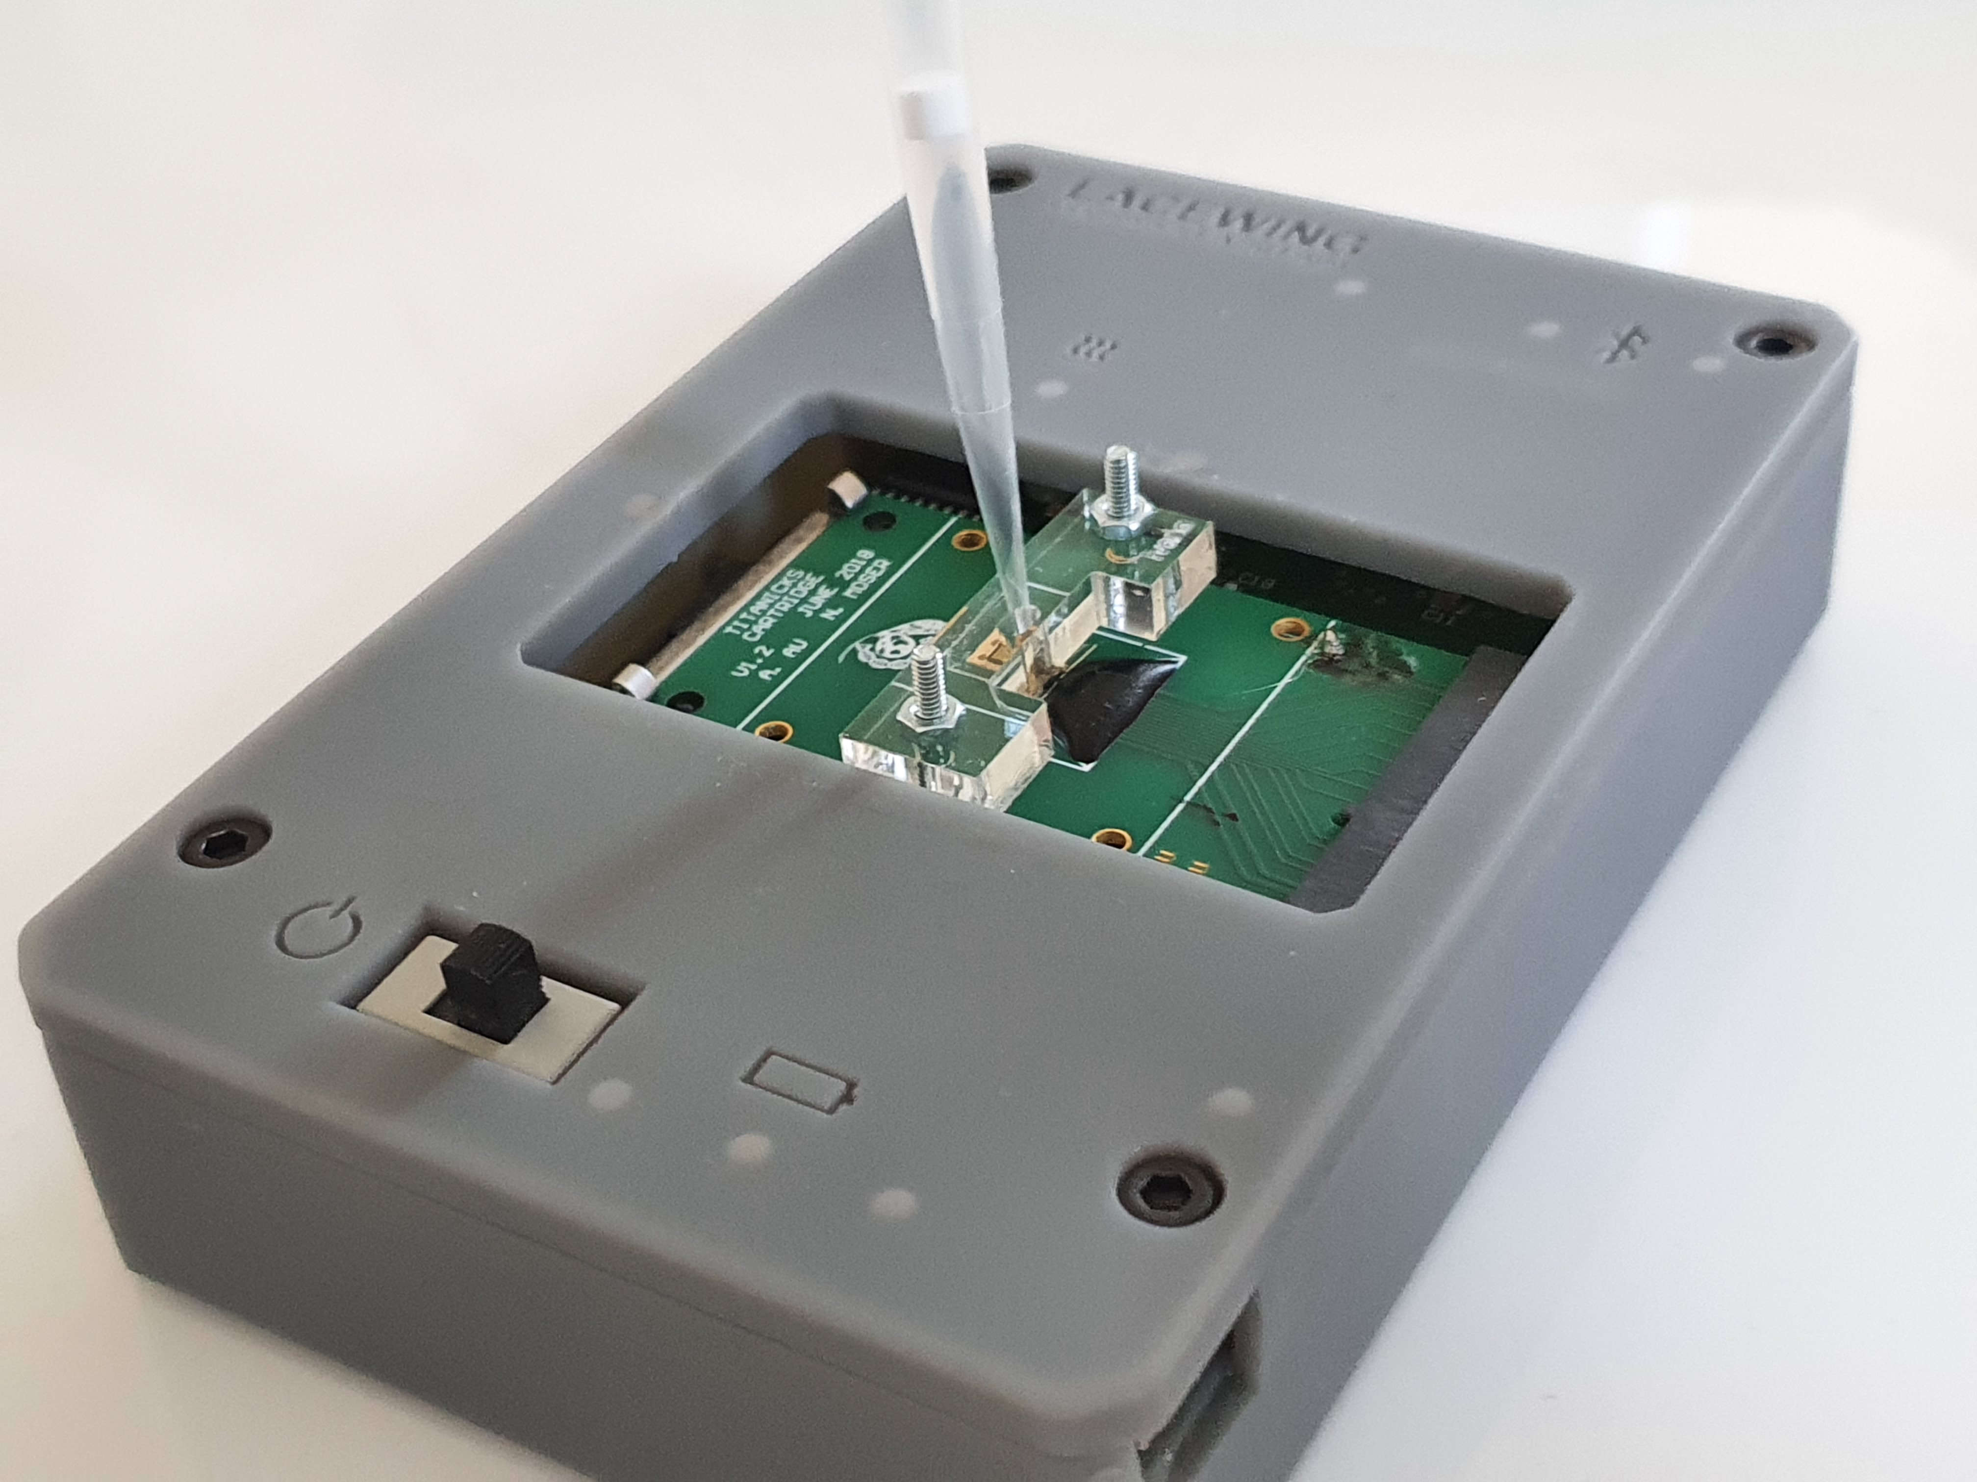
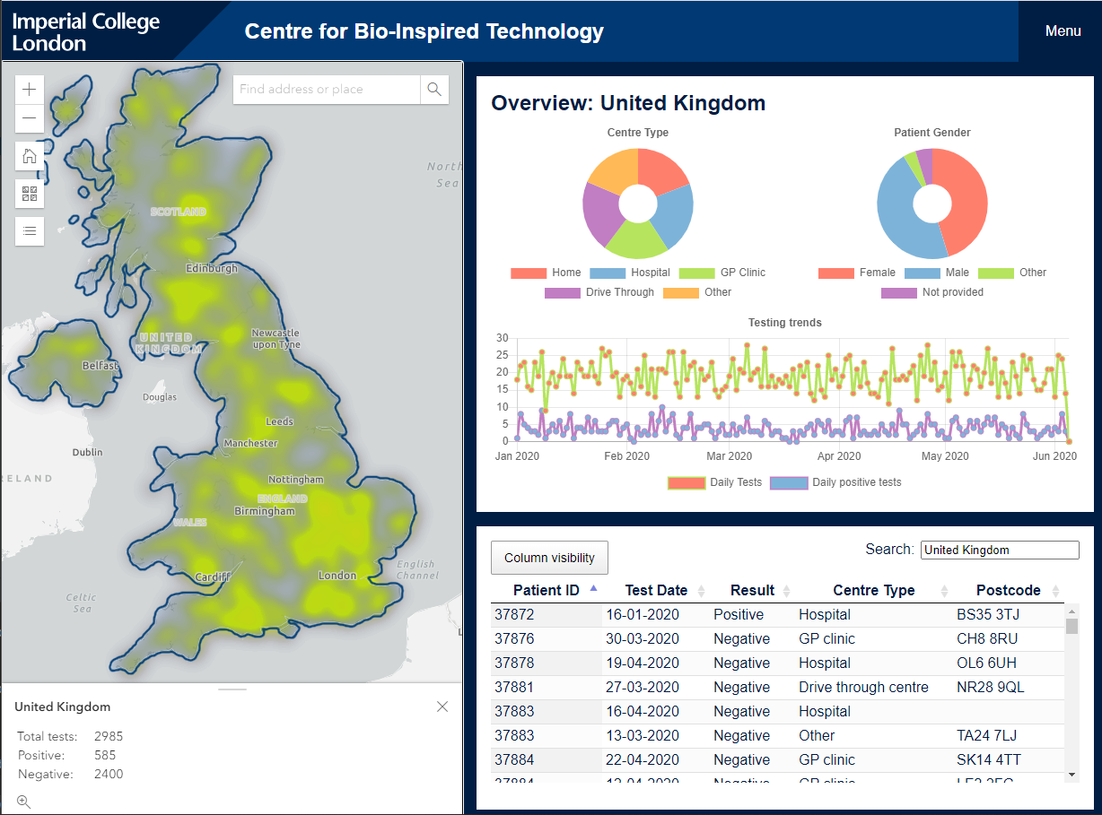



Chen Su & Oliver Stiff
1
2
COVID-19 Tracking
Data visualisation platform
1.Visualise data on a country-wide basis all the way down to a single postcode
2.Detailed individual case analysis
The platform allows for accurate visualisation of diagnostics at global, national, and regional scales.
UK->England->London->Westminster
->Knightsbridge and Belgravia->SW7 2AZ
Detailed case analysis is made possible through a patient specific view available to clinicians.
PCR graph + clinician comment
3
4
3, Data analysis & Rel-time data updating
4.User-friendly uploading and administrator
interfaces
Intuitive and easy to use visualisation interface helps to analyse data and identify trend.
Regularly updated with latest data from NHS and Office for National Statistics when it becomes available.
A streamlined interface allows clinicians to review and verify data before it gets added to the database.
Easy and painless management by only dragging and dropping data files.
No technical knowledge required.
Completely cost free
Slide / 3
Notes:
To address this issue, the team from Imperial College Centre for bio-inspired technology has came up a portable, inexpensive, and reliable diagnostic platform, Lacewing. It is able to provide point-of-care test results under 20 minutes, and the data can be stored in cloud immediately for further processing. Early, prompt, remote, and accurate diagnosis is definitely essential for disease management and control. In order to provide more comprehensive and more intuitive results from data that collected from the platform, we have developed our pandemic visualization platform, which contains both general information and individual analysis. Visualisation platform allows us to aggregate data (possibly from different organisations) to see where more testing is needed / what areas have been impacted most. Detail view allows clinicians to easily go back and see comments they left for a certain test / if someone is coming in for a new test, a clinician can see if they've had previous tests and all the information related to it.
( Play a complete video present how the website is working. )
Our visualization has several attractive selling points. We support most detailed geolocation classification with both negative and positive testing results available, unique detailed individual analysis, real-time data updating, visualization of data analysis, user-friendly uploading and administrator interfaces.

Slide 4
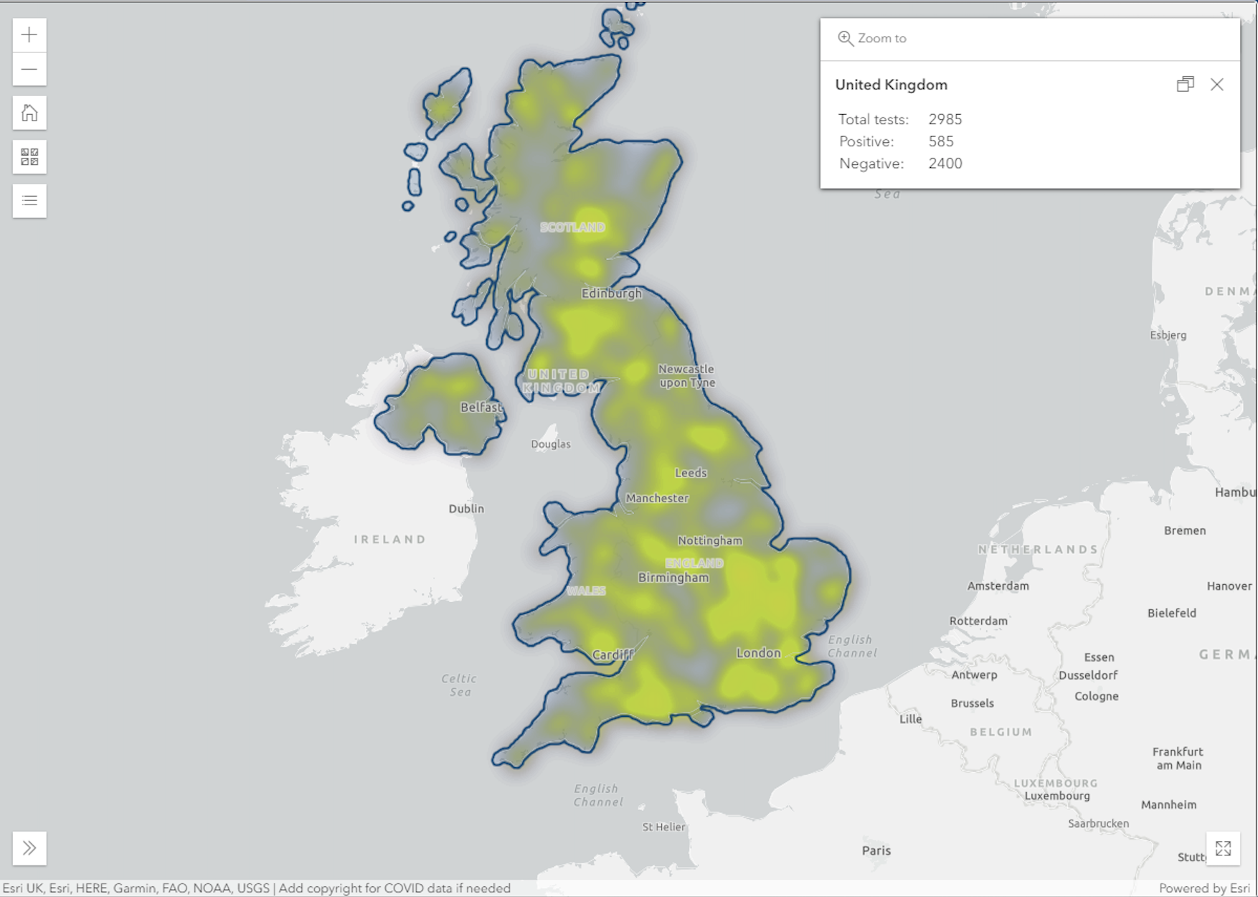
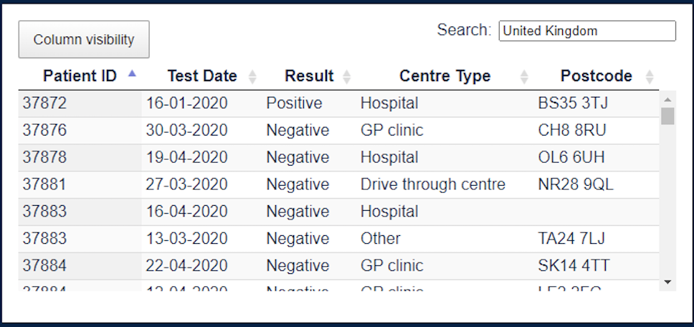
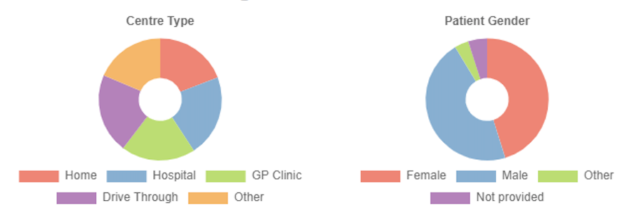
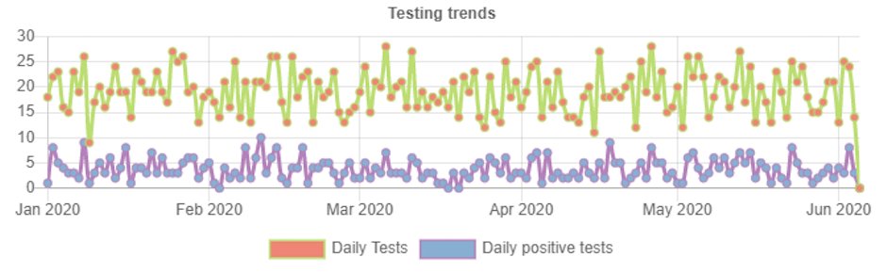
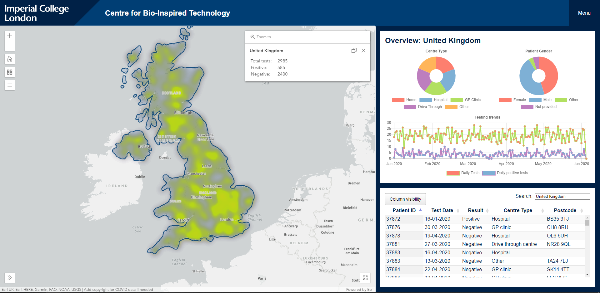
Chen Su & Oliver Stiff
The Dashboard
Map
Table
Composition analysis
Trend analysis
Powered by ArcGIS with fast GPU accelerated drawing and client-side analytics.
Powered by DataTables, a plug-in for the jQuery JavaScript library. A highly flexible tool adds advanced features to any HTML table
Powered by Chartjs, a powerful, interactive charting and visualization library for browser.
Powered by Chartjs, a powerful, interactive charting and visualization library for browser.
Rich interactive data visualizations with ArcGIS APIs and SDKs in 2D with various basemaps.
A collection of global geographic information from Esri
Data-driven styling with both heat and dot data layers available.
Convert your addresses and place names into coordinates and put them on a map.
Interactive graphs.
Plotted using data collected directly from the map on client side.
User can show or hide data
Great rendering performance across all modern browsers
Multi-chart interaction:
Analysis the relationship between multiple charts
Plot complex, sparse datasets on date time, logarithmic or even entirely custom scales with ease.
Redraws charts on window resize for perfect scale granularity.
Interactive table with search and sorting
User chooses what columns to show and what to sort by.
Linked to individual analysis with authority required
Resize table dynamically with the page.
Slide / 4

Slide 5
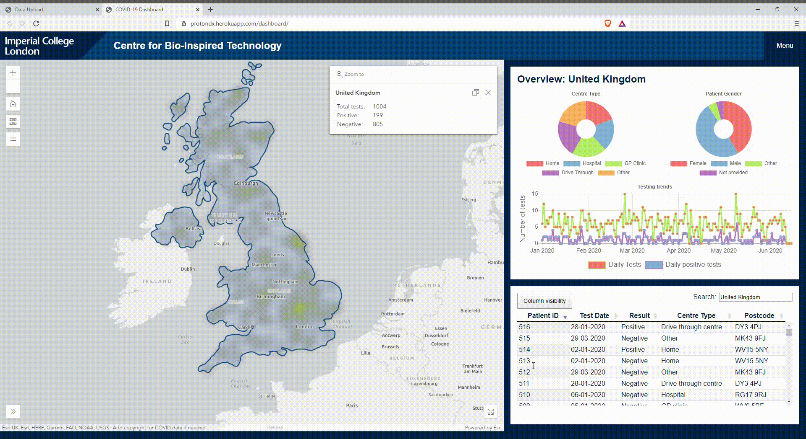
Chen Su & Oliver Stiff
Individual analysis interface
A pop-up window: Easily accessible to other cases’ analysis
PCR graphs: allowing clinicians to visualise the data when predicting how likely it is to be a positive case.
Diagnostic comments: exclusive comments that help anyone who is interested in clearly understand the specific situation of each patient.
Testing history/Tracking history: Better understand a range of activities and the morbidity process of each patient.
Information overview: Intuitively present all important information.
Secure privacy protection: All patients are labeled with their unique patient ID. Only visible for for clinicians/doctors with access authority required.
Continue…
Slide / 5

Slide 6
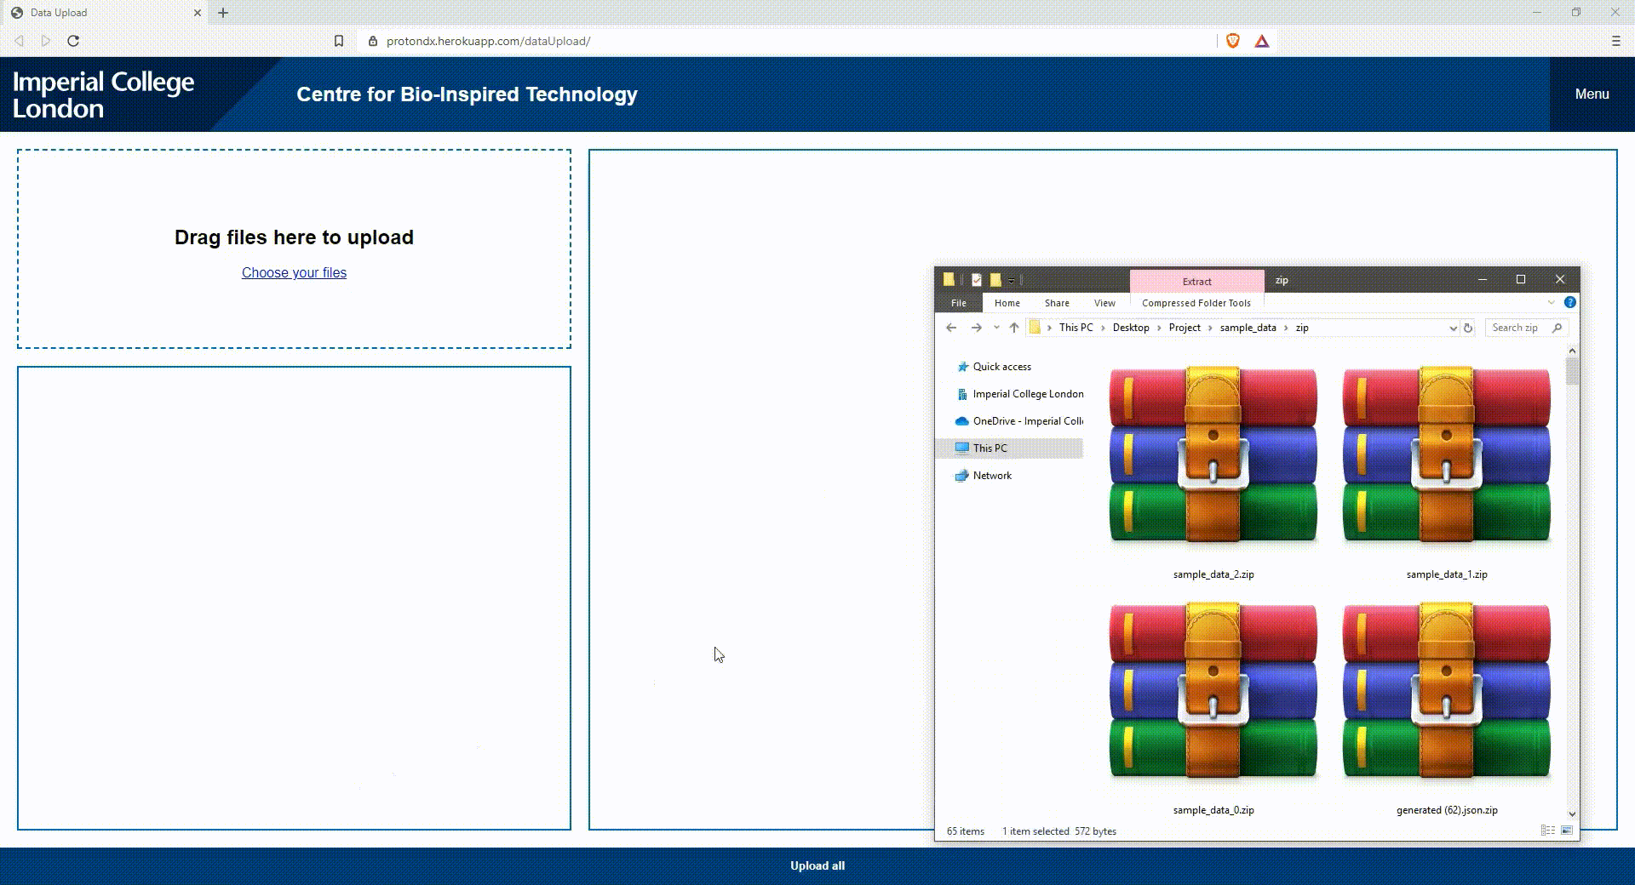
Chen Su & Oliver Stiff
User-friendly admin and uploading interface: quick and convenient uploading
The uploading interface
Drag and drop ZIP archives containing experiment data
Files are extracted and displayed in a form where information can be reviewed or amended.
The updated data is uploaded and ready to be displayed. The original data is preserved, and user credentials are logged for reference.
Continue…
Slide / 6

Slide 7
Static pages

Slide 8
Chen Su & Stiff Oliver
The impact of COVID-19 on the world
-5.2%
Global economy
By World
Bank[1]
6.93 Million+
confirmed cases & 400,000+
Deaths
by WHO[2]
Estimated
$8.8 Trillion+
economic loss by ADB[4]
Estimated
195 million+ unemployment
by ILO[3]
[1] “Global Economic Prospects.” World Bank, 9 June 2020, www.worldbank.org/en/publication/global-economic-prospects.
[2] WHO Coronavirus Disease (COVID-19) Dashboard. World Health Organization, World Health Organization, 8 June 2020, covid19.who.int/.
[3]“As Job Losses Escalate, Nearly Half of Global Workforce at Risk of Losing Livelihoods.” ILO, 29 Apr. 2020, www.ilo.org/global/about-the-ilo/newsroom/news/WCMS_743036/lang--en/index.htm.
[4] “COVID-19 Economic Impact Could Reach $8.8 Trillion Globally - New ADB Report.” Asian Development Bank, 15 May 2020, www.adb.org/news/covid-19-economic-impact-could-reach-8-8-trillion-globally-new-adb-report.
Slide / 8

Slide 9
Chen Su & Stiff Oliver
The impact of COVID-19 on the UK
Estimated -12.8%
GDP growth rate
by OBR[5]
286,000+
confirmed cases &
40,000+
Deaths
by WHO[6]
2
Intensive needs of PPE, ventilators, critical care beds, and medical staff
by NHS[8]
Estimated
1.35 million+ unemployment
by ONS[7]
1
[5]“Coronavirus Analysis.” Office for Budget Responsibility, 22 May 2020, obr.uk/coronavirus-analysis/.
[6] WHO Coronavirus Disease (COVID-19) Dashboard. World Health Organization, 8 June 2020, covid19.who.int/.
[7]Freeman, David. “Coronavirus and the Effects on UK Labour Market Statistics.” Office for National Statistics, Office for National Statistics, 5 May 2020, www.ons.gov.uk/employmentandlabourmarket/peopleinwork/employmentandemployeetypes/articles/coronavirusandtheeffectsonuklabourmarketstatistics/2020-05-06.
[8] Hatherley, Sarah, et al. “Coronavirus: NHS Activity and Capacity.” IN BRIEF, 14 May 2020, seneddresearch.blog/2020/05/14//.
coronavirus-nhs-activity-and-capacity
Slide / 9

Slide 10
Chen Su & Stiff Oliver
1
2
COVID-19 Tracking
Data visualisation platform
1.Visualise data on a country-wide basis all the way down to a single postcode
2.Detailed individual case analysis
The platform allows for accurate visualisation of diagnostics at global, national, and regional scales.
UK->England->London->Westminster
->Knightsbridge and Belgravia
Detailed case analysis is made possible through a patient specific view available to clinicians.
PCR graph + clinician comment
3
4
3, Data analysis & Rel-time data updating
4.User-friendly uploading and administrator
interfaces
Intuitive and easy to use visualisation interface helps to analyse data and identify trend.
Regularly updated with latest data from NHS and Office for National Statistics when it becomes available.
A streamlined interface allows clinicians to review and verify data before it gets added to the database.
Easy and painless management by only dragging and dropping data files.
No technical knowledge required.
Completely cost free
Slide / 10

Slide 12
Chen Su & Stiff Oliver
The Dashboard
Map
Table
Composition analysis
Trend analysis
Powered by ArcGIS with fast GPU accelerated drawing and client-side analytics.
Powered by DataTables, a plug-in for the jQuery JavaScript library. A highly flexible tool adds advanced features to any HTML table
Powered by Chartjs, a powerful, interactive charting and visualization library for browser.
Powered by Chartjs, a powerful, interactive charting and visualization library for browser.
Rich interactive data visualizations with ArcGIS APIs and SDKs in 2D with various basemaps.
A collection of global geographic information from Esri
Data-driven styling with both heat and dot data layers available.
Convert your addresses and place names into coordinates and put them on a map.
Interactive graphs.
Plotted using data collected directly from the map on client side.
User can show or hide data
Great rendering performance across all modern browsers
Multi-chart interaction:
Analysis the relationship between multiple charts
Plot complex, sparse datasets on date time, logarithmic or even entirely custom scales with ease.
Redraws charts on window resize for perfect scale granularity.
Interactive table with search and sorting
User chooses what columns to show and what to sort by.
Linked to individual analysis with authority required
Resize table dynamically with the page.
Slide / 12

